Slide 1
CrossTalk: Cross Layer Decision Support Based on global Knowledge
Rolf Winter, Jochen H. Schiller (Freie Universitat Berlin)
Navid Nikaein, Cristian Bonnet ( Institut Eurocom)

Slide 2

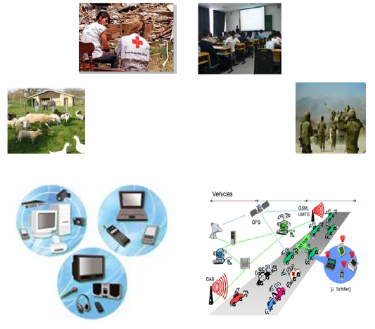

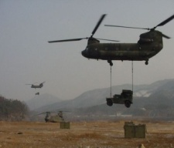
Introduction
Mobile Ad hoc Networks (MANETs)
Lack of central administration
Mobility
Dynamic context
Wireless medium
Unstable routes
Severe performance problems
Resource constrained
Cross-layer architectures are promising new approach to adapt protocol behavior to changing networking conditions

Slide 3
Objective
In such a context,
Propose a cross-layer architecture aiming at achieving global objetcives with local behavior

Slide 4
Outline
Introduction
When it is perefered to use cross-layering
Cross-talk architecture
Quality of the global view
Perforamnce results
conclusion

Slide 5
Introduction
Classical protocol stack structure
Monolothic stack
Layered protocol
less design complexity: the well-defined functional entities
Improved maintainability:modular nature
High degree of flexibility: independent function of different layers (allow arbitrary combinations of protocol classes)

Slide 6
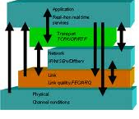
Cross-layering
Utilization of information of one layer to improve the performance of another layer
Power & topology control, energy efficiency, QoS, etc.

Slide 7
Cross-layer concept
Information can be shared among layers
This information can be used to adapt protocol functionality in the presence of changing network conditions
Decision process
Input for algorithms
Create new kinds of adaptive applications: multimedia applications
Ultimate goal:
preserve the key characteristics of a layered architecture
Allow for performance improvements and a new form of adaptation ability

Slide 8
Cross-layering Open issues
When interaction between layers
Designing protocols truly independently might not be possible anymore
Security
Protocol stability => adaptation loop
Challenges
Performance & adaptability
Adaptation loops
Layered architecture
Centrally administrated large infrastructure-based reliable and commercially operated networks
Cross-layer design
Difficult communication aspects, poor computational power in Dynamic networks (e.g. ad hoc networks)

Slide 9
Cross-talk design
Both local and global view influence the protocol behavior
Example of global views
Energy level
Communication load
Neighbor degree
Global view utility
A node can compare its local status against the global status of the network => evaluate its own relative status

Slide 10
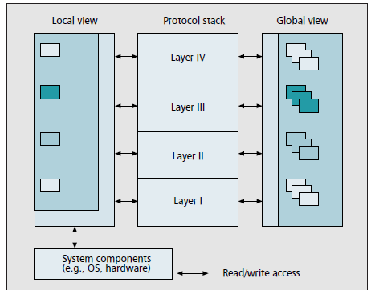
Cross-talk design

Slide 11
Architecture details
Organisation of locally available information
Data Management Entities
Organisation of network-wide information
Local view
Global/network-wide view
From protocol stack layers
Data dissemination procedure
battrey level, load, neighbor count, SNR, transmit power, location, velocity
battrey level, load, neighbor count, SNR, transmit power, location, velocity
Same type of inforamtion collected in local view

Slide 12
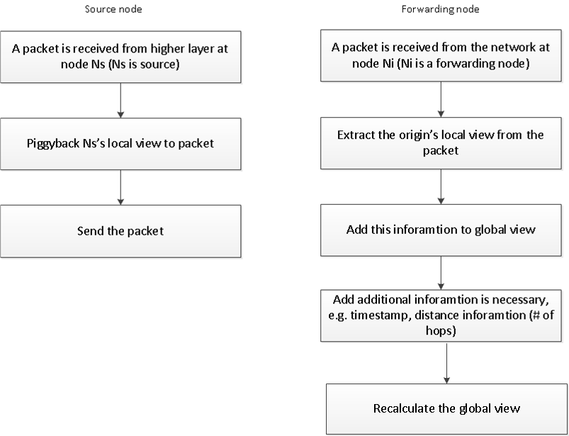
Data dissemination procedure

Slide 13
Data dissemination procedure: advantages
No separate packets to disseminate local views
Only the source of packet adds information
Are all local views distributed in entire network?
IN OTHER WORDS
Do calculated global views represent correctly the network-wide status?
Avoid extra headers’ overhead
Packet size only marginally increased
LOW overall overhead and fragmentation due to packet size

Slide 14
Collected data aggregation
Global view: aggregation of collected data to represent more significant data
Simple mean
Weighted moving average
Time weighting factor: reflects up-to-dateness of global view (insertion time)
Distance weighting factor: reflects spatial dependencies of information (topological distance in hops)
Include/exclude samples from neighbor nodes
Due to their similar local view, e.g. neighbor count
More often add information to global view
Make sense for non-spatial dependet metrics, e.g. battery level
Global view should reflect accurate global state:
be constructed based on sufficient number of samples: on-off policy

Slide 15
Collected data aggregation
Weighting function | Weighting factor | Aggregation method
 |  | Simple mean
Temporal weighted moving average | Temporal | Weighted Moving Average
Linear weighting function: most weight to most recently entered sample (smooth the effect of small temporal fluctuations) Exponential weighting function: exponentially more weight to recent samples (more rapidly respond to sudden metric changes)
Spatial weighted moving average | spatial
Linear weighting function: most weight to samples coming from distant nodes Triangular weighting function: least weight to samples from the closest nodes and also to the most distant nodes and the highest weight to samples from nodes with a medium distance

Slide 16
Quality of global view
Global view quality Metrics
Comparison of the perfect global view (the average of all local view values from every node) with the average of all global views in the network
Standard deviation of all global views: degree of uniformity of global views
Correctness: the fraction of nodes able to evaluate their relative state correctly
Node relative status against the perfect global view: comparison of node’s local view with the perfect global view (above or below)
Node relative status against the node’s estimated global view: comparison of node’s local view with the node’s global view

Slide 17
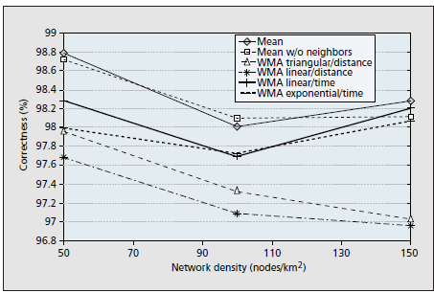
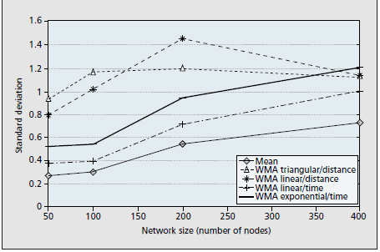
Quality of global view
Value | Parameter
50 to 400 nodes | Network size
50 to 150 nodes/km2 | Network density
Random Waypoint Model | Mobility model
0.5 to 2 packet/sec | Packet rate
Nodal load | Local view parameter

Slide 18
CrossTalk applied: A node logical view
If (!enough data to construct global view ) OR (the node is not overloaded)
NO
YES
Cross-layer optimization
Normal layered mode

Slide 19
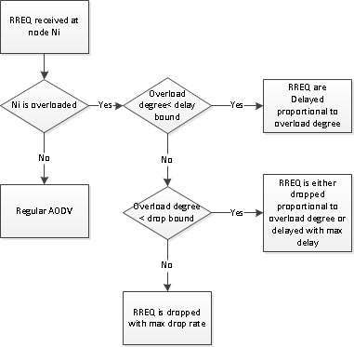
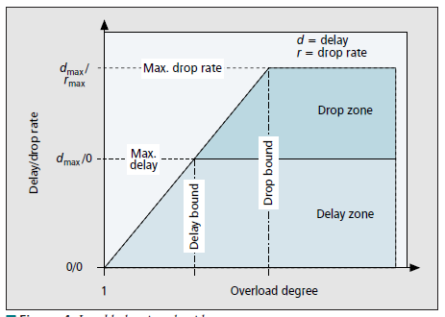
CrossTalk applied
AODV route request procedure
If a node is overloaded, accepting new routes going through it will result in an even higher routing burden
The probability that routes go through the core of the network is high → Push routes to the edge

Slide 20
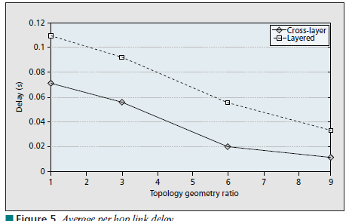
Cross-talk: routing application
Per-hop delay reduced by 65%
Load of bottleneck nodes lowered by up to 25%

Slide 21
Conclusion
CrossTalk, a promising cross-layer framwork using global network knowledge for local decisions
High quality of global view
Relevent optimization of QoS performance in terms of delay and individual nodal loads compared to original AODV
Future works
Reduce the produced overhead
Other cross-layer adaptations, e.g. predicting node mobility

Slide 22
Questions?
What is the main characteristic of CrossTalk differentiating it from other cross-layer frameworks?
Did the presented approach perfoms better than the poor flooding precedure? Why?
What was the asset of cross-layer in CrossTalk architecture?
Do you think that CrossTalk could be regarded to as an autonomic solution? Why? What should be added to CrossTalk to enable it performs the self-properties?
What other evaluations do you propose to show all feautures of CrossTalk?
What other mechanism do you propose for disseminating local views? Explain.

